Slide 1
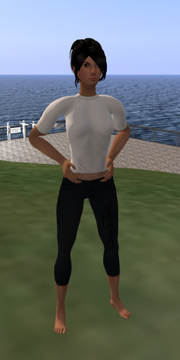
Max – Maxine & Maxwell
Open Source Mesh Avatars
Full details at
https://blog.inf.ed.ac.uk/atate/max-history/

Slide 2
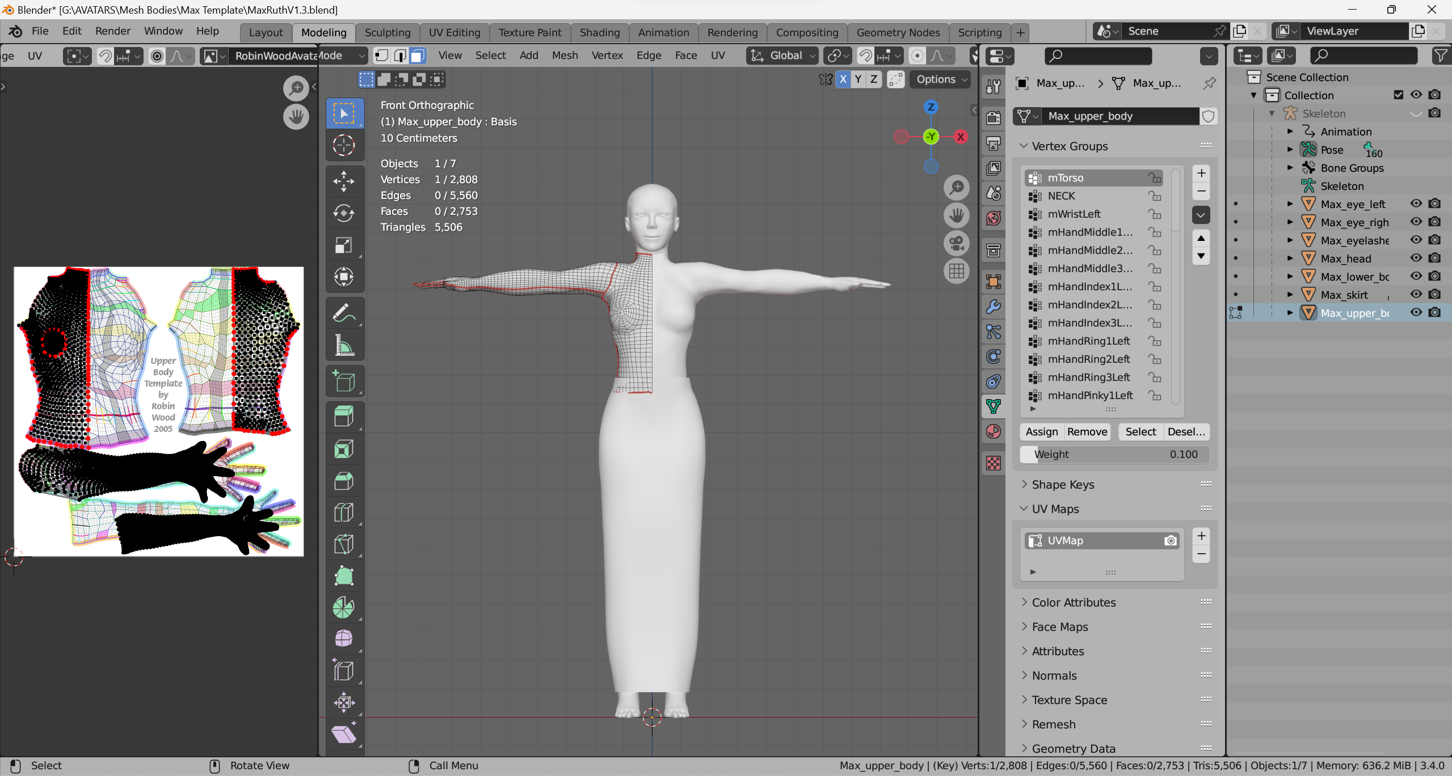
Max – Maxine and Maxwell
The new underlying avatar created directly in Blender by Ada Radius is called “Max” which can be morphed into female and male variants called “Maxine” and “Maxwell”.
Max is being developed under the “RuthAndRoth” GitHub organization as an educational resource by the existing community for open-source mesh avatars.
The Max avatar armature is refined via research on the character folder in Second Life/OpenSim viewers https://github.com/New-Media-Arts-New-Viewer-Avatar

Slide 3
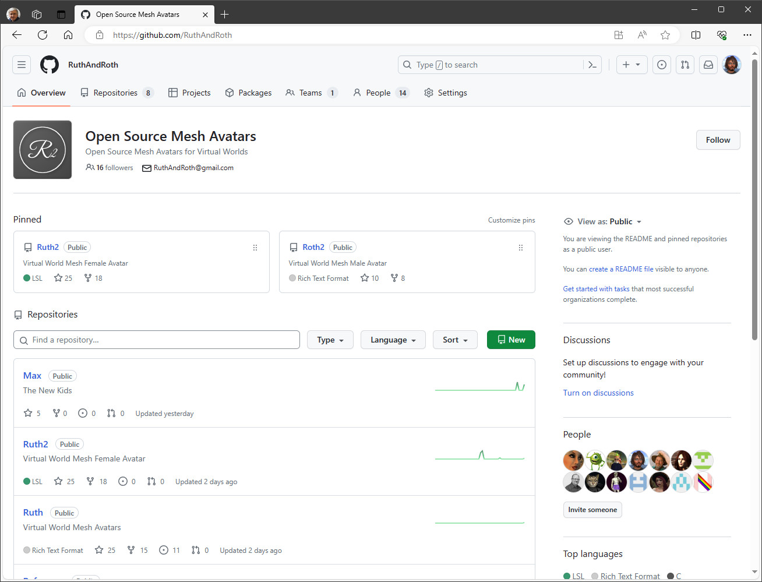
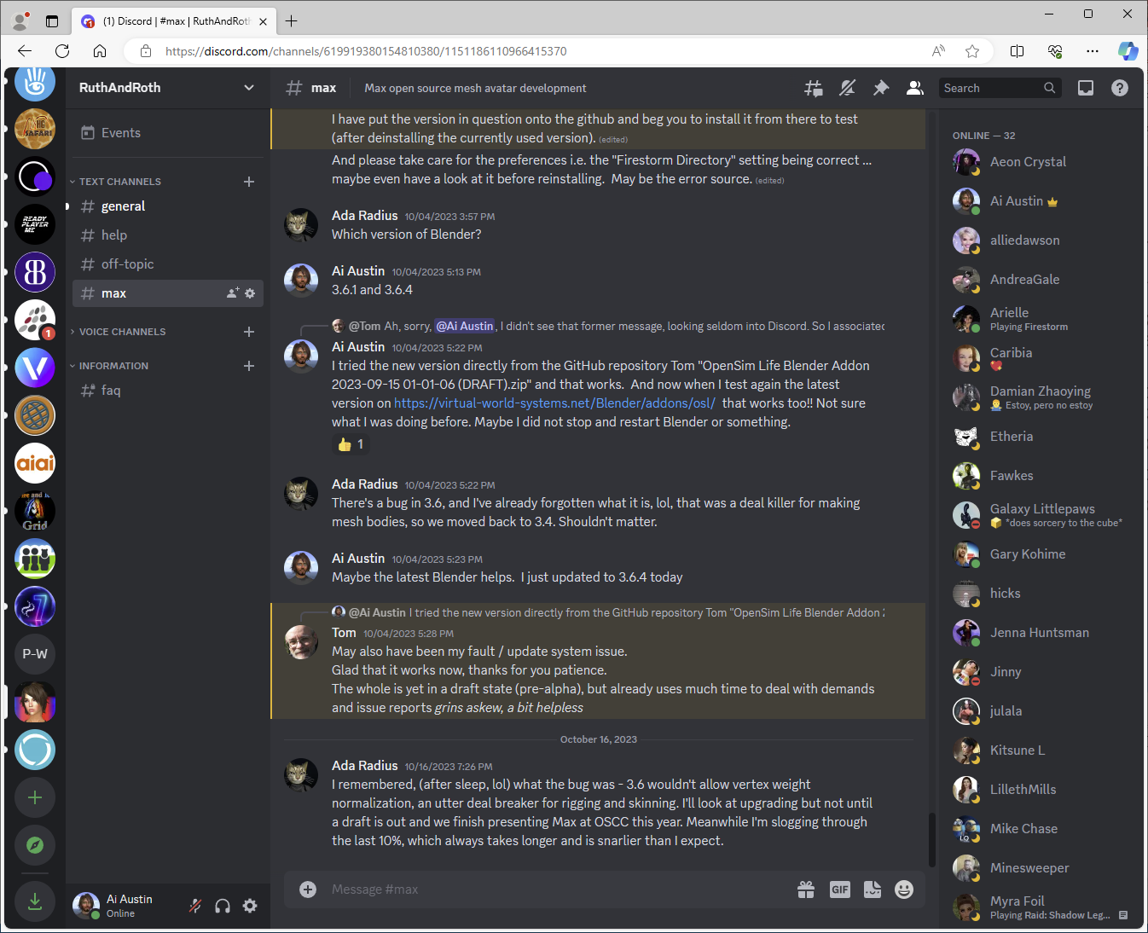
GitHub RuthAndRoth Organization
GitHub Organization
Multiple Repositories for Ruth2, Roth2, Extras, Skins, Reference materials, etc.
“Contrib” directories for inputs and drafts.
Issues and Discussion
Wiki for documentation
Max Repository
Discord Discussions

Slide 4
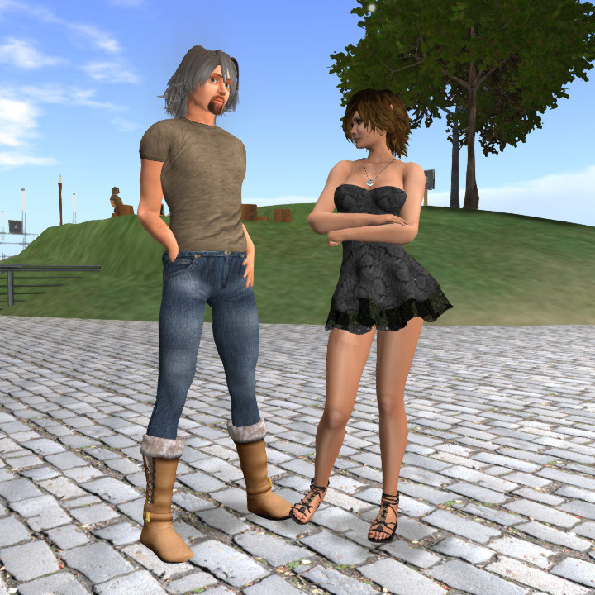
Short history of the RuthAndRoth project, current Ruth2 and Roth2 avatars & community social media channels.
Full details at
https://blog.inf.ed.ac.uk/atate/max-history/

Slide 5
RuthAndRoth Timeline
2017 – Shin Ingen creates original Ruth 2.0 and Roth 2.0 avatar meshes in ZBrush. https://github.com/ingen-lab/Ruth
2019 – Fred Beckhusen creates GitHub RuthAndRoth organization to improve open-source community management of the project with Ada Radius, Ai Austin and Serie Sumei as administrators. https://github.com/RuthAndRoth
2019 – Ruth 2.0 RC#2, Ruth 2.0 RC#3 and Roth 2.0 RC#1 resources archived as branches in https://github.com/RuthAndRoth/Ruth
2019 – Ruth2 v4 and Roth2 v2 released by GitHub RuthAndRoth organization into OpenSim and Second Life. “Contrib” directories for contributions. https://github.com/RuthAndRoth/Ruth2 and https://github.com/RuthAndRoth/Roth2
2022 – Ada Radius, Kayaker Magic and Tom Ernst explore details of viewer data for avatars as basis for Max. https://github.com/New-Media-Arts-New-Viewer-Avatar
2023 – Max, Maxine and Maxwell Project underway. https://github.com/RuthAndRoth/Max

Slide 6
Resources and Social Media
Note not all the resources below will contain Max, Maxine or Maxwell relevant content at this early stage.
GitHub:
  Github Organization: https://github.com/RuthandRoth
  Github Repositories: Ruth, Reference, Skins, Ruth2, Roth2, Max
Social Forums and Discussion:
  Discord Discussion Forum: RuthAndRoth [See channel #max] [Invite: https://discord.gg/UMyaZkc]
  MeWe Community Page: https://mewe.com/group/5bbe0189a5f4e57c73569fb9
Second Life:
  Second Life Groups: “RuthAndRoth” and “Ruth and Roth Community”
  Second Life Marketplace Store: ”RuthAndRoth” (ensure “Adult” content is allowed)
OpenSim:
  OSGrid inworld location for testing and distribution: hop://hg.osgrid.org:80/RuthAndRoth/134/124/26
  OpenSimulator Community Conference (OSCC) Grid alternative location for distribution: hop://cc.opensimulator.org:8002/OSCC%20Shopping%20Zone/256/242/86
  OSGrid OpenSim Group: “RuthAndRoth”

Slide 7
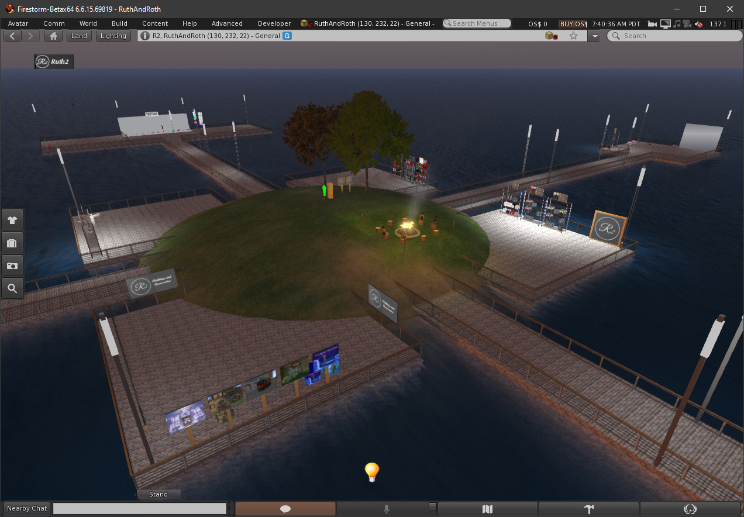
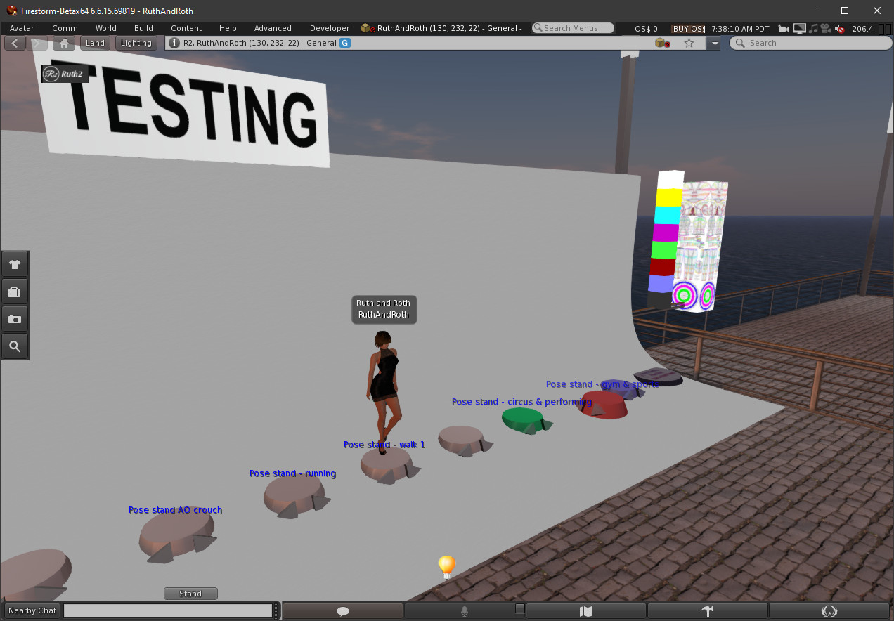
OpenSim (OSGrid) RuthAndRoth Testing Region

Slide 8
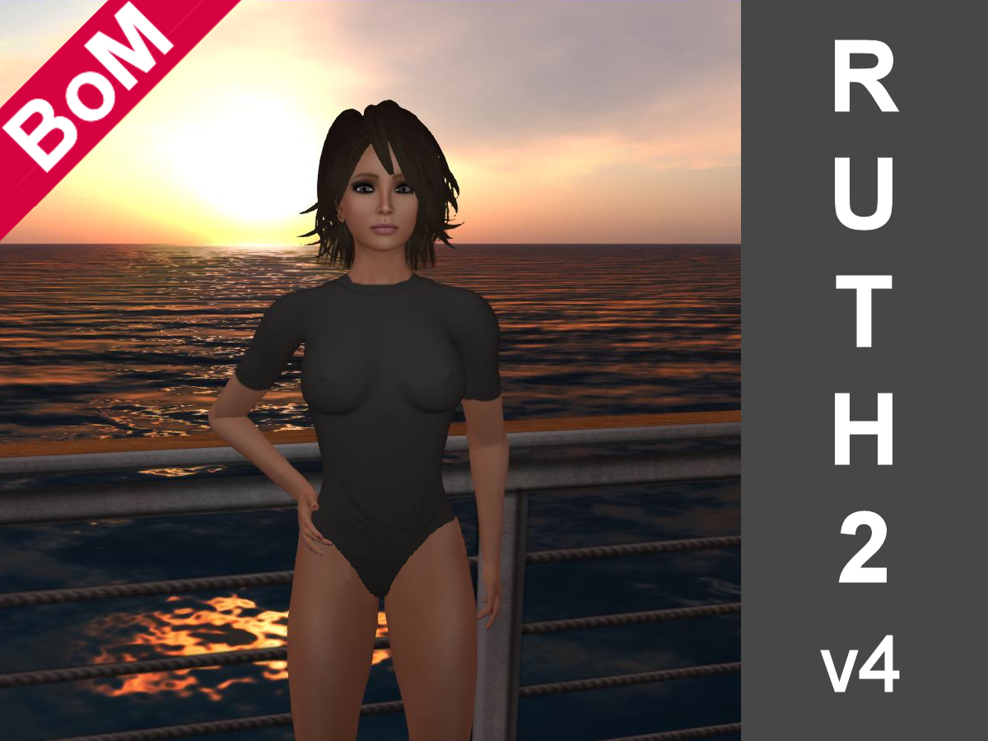
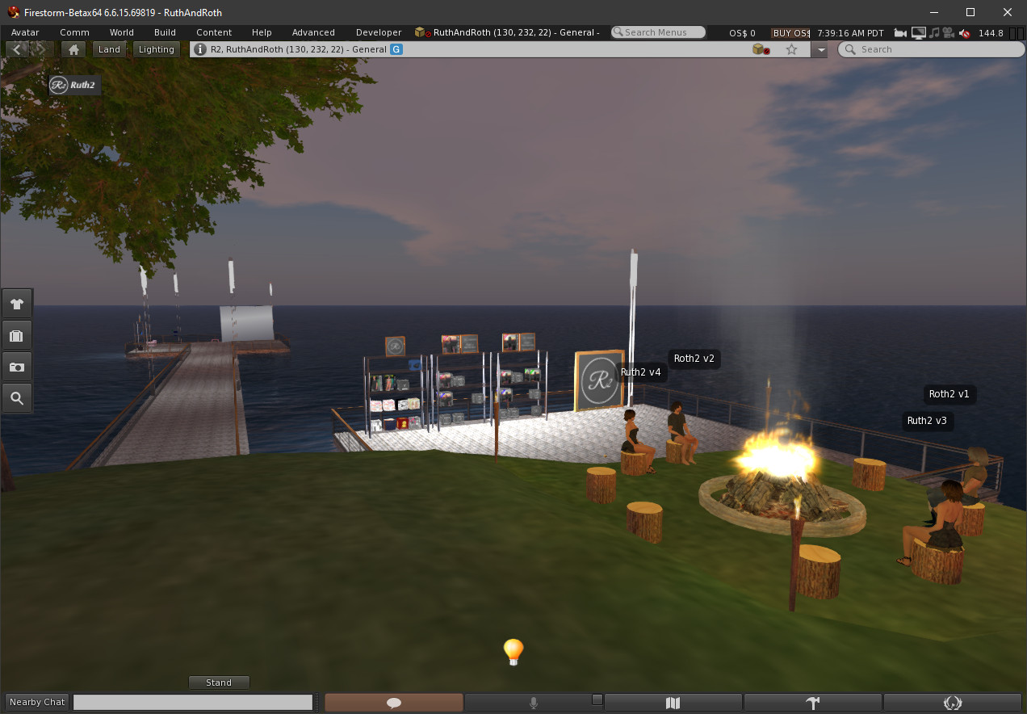
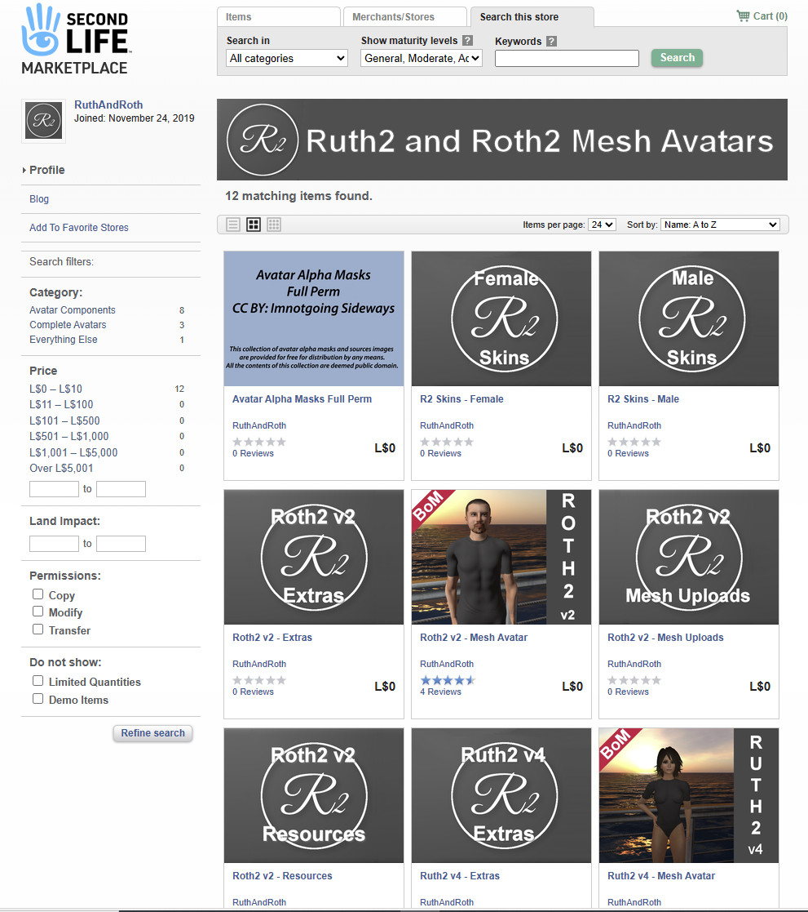
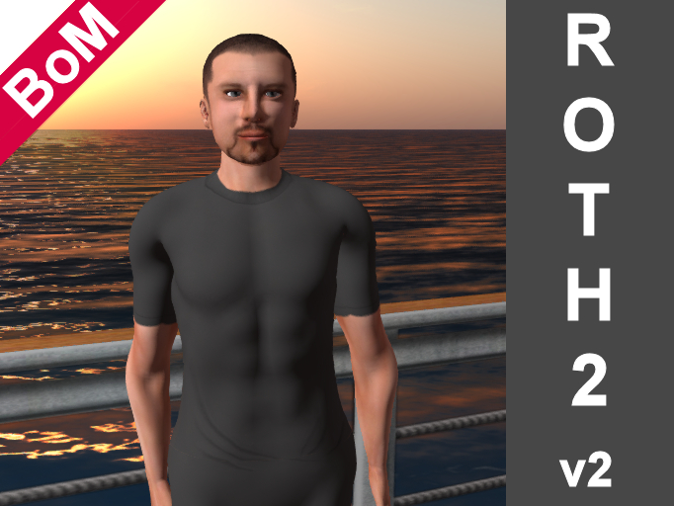
OpenSim and Second Life Boxed Distributions

Slide 9
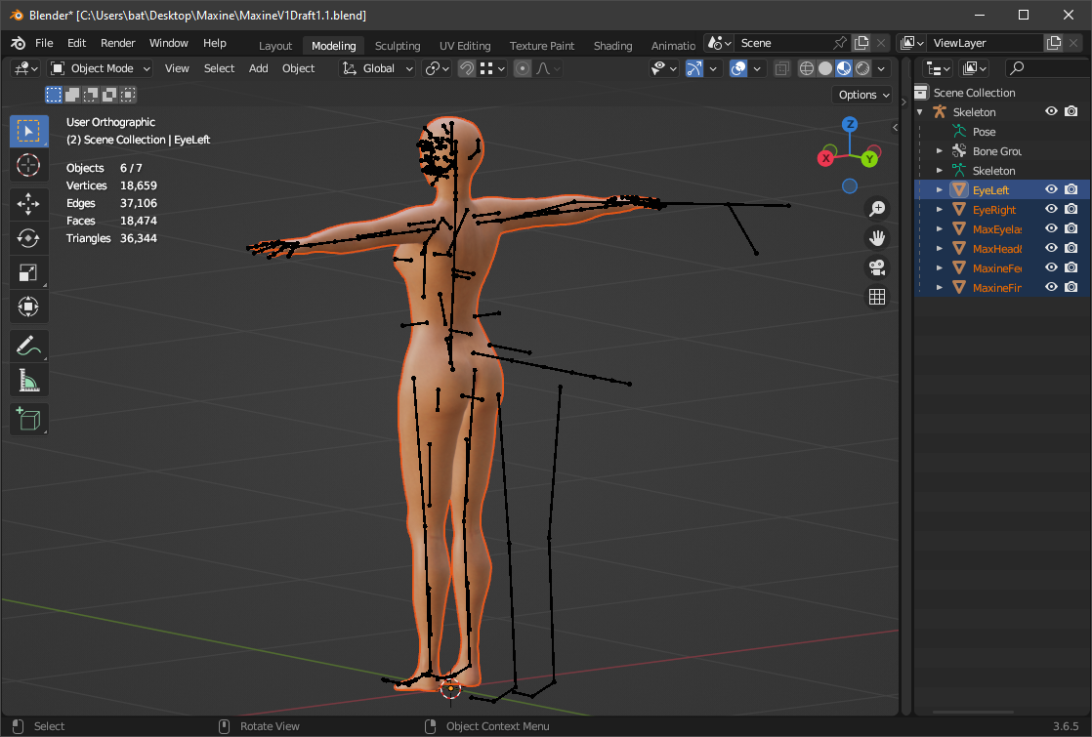
Maxine – Current Draft

Slide 10
RuthAndRoth & Max Contributors
Original Ruth 2.0 RC#1, RC#2 and RC#3 and Roth 2.0 RC#1 meshes modelled in Zbrush by Shin Ingen with rigging and vertex weight maps by Ada Radius from 2017 to 2018 with improvements in 2019.
GitHub Repository management, testing and in-world packaging by Fred Beckhusen, Outworldz LLC (Ferd Frederix), Ai Austin and Serie Sumei.
Revised mesh, rigging and vertex weight maps by Ada Radius.
Improvements to feet meshes by Sundance Haiku and Curious Creator.
Fingernails and toenails by Sundance Haiku.
UV map is CC-BY Linden Lab.
HUD mesh, textures and scripts by Serie Sumei using modifications to original scripts by Shin Ingen and nail enhancements by Sundance Haiku.
Full details at https://blog.inf.ed.ac.uk/atate/max-history/
Contributors to Ruth2 v4 and Roth2 v2 Development (18)
Ada Radius
Ai Austin
Chimera Firecaster
Duck Girl
Elenia Boucher
Fred Beckhusen
Fritigern Gothly
Joe Builder
Kayaker Magic
Contributors to Max (currently 8)
Ada Radius
Ai Austin
Curious Creator
Kayaker Magic
Linden Lab
Serie Sumei
Sundance Haiku
Tom Ernst (aka Owl Eyes)
Lelani Carver
Leona Morro
Linden Lab
Mike Dickson
Noxluna Nightfire
Sean Heavy
Serie Sumei
Shin Ingen
Sundance Haiku

