Slide 1


Notes:
Robots.
Introductory talk by Prof. Austin Tate at National Museum of Scotland, Edinburgh on 29th March 2019.

Slide 2
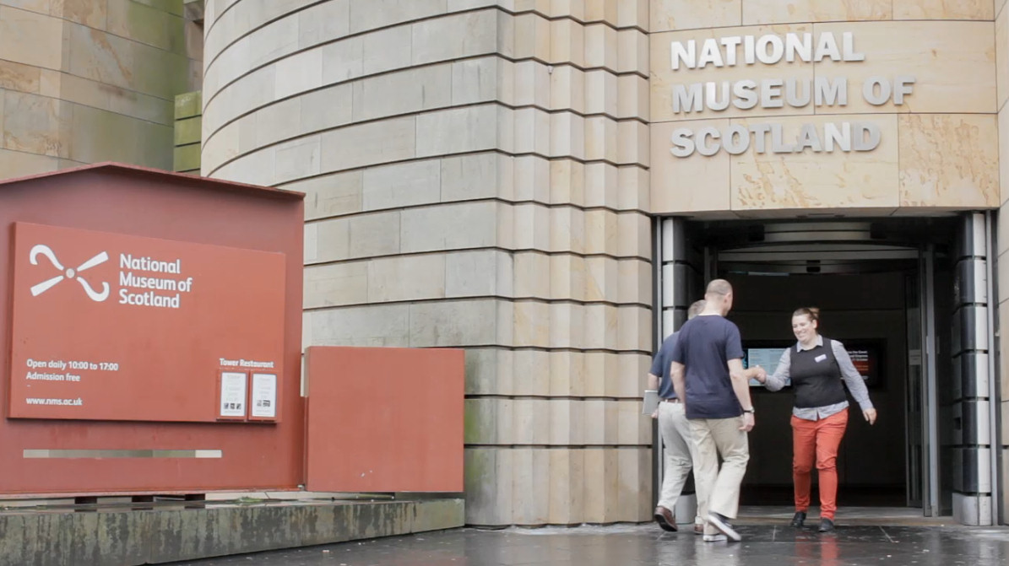
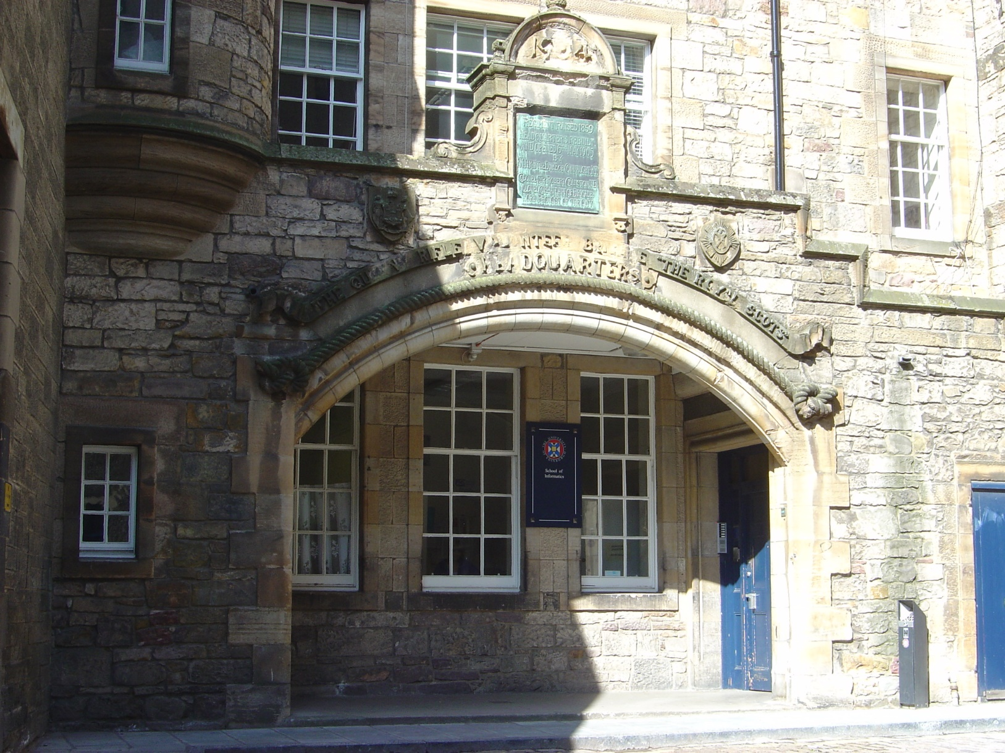
Notes:
National Museum of Scotland, Chambers Street, Edinburgh.
Home of Freddy and Freddy II in Drill Hall, University of Edinburgh, Forrest Hill, Edinburgh

Slide 3
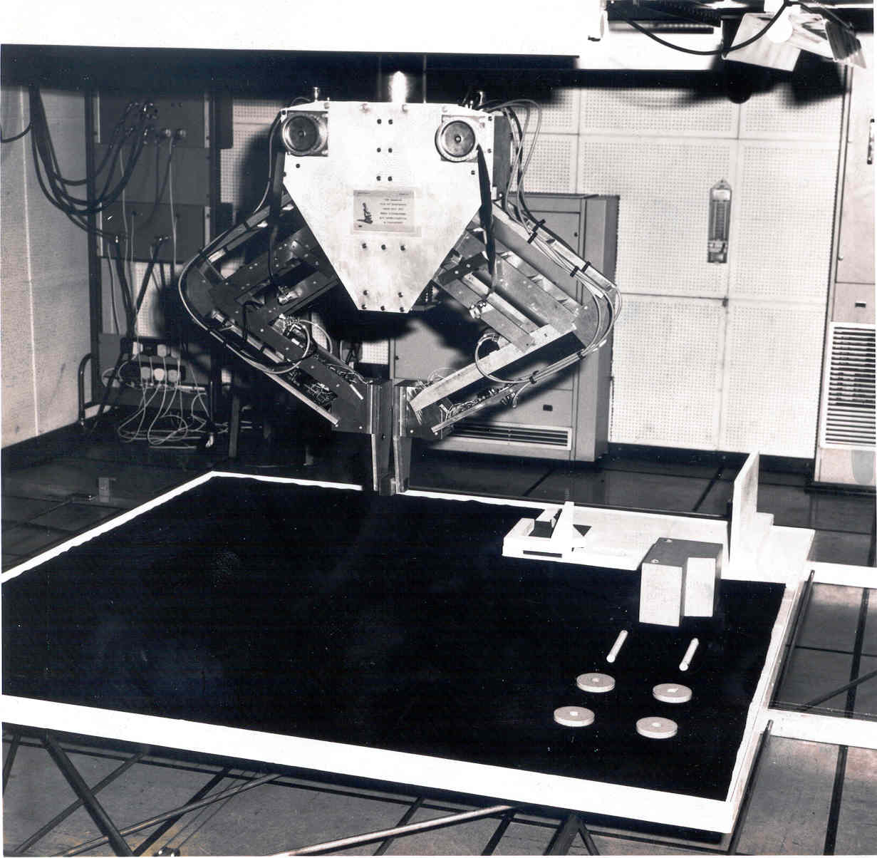
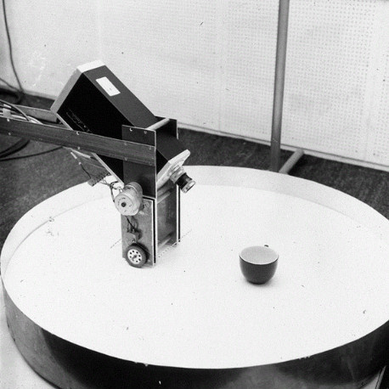
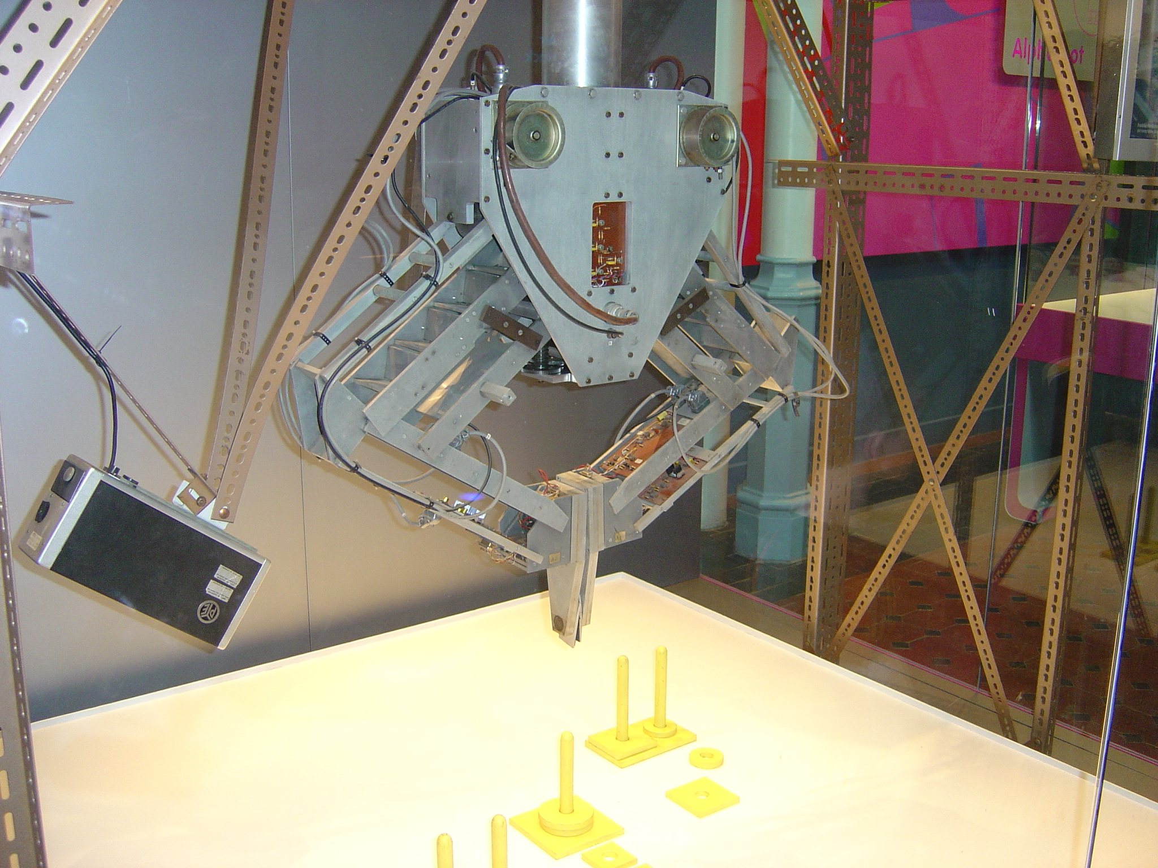
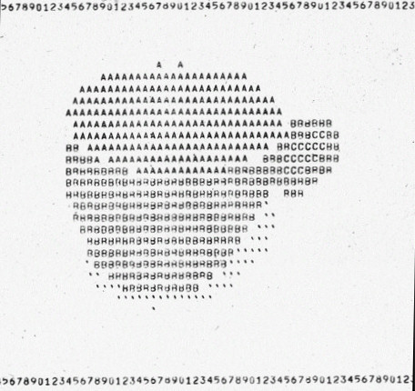
Notes:
Freddy table and camera with vision of cup, 1969.
Freddy II in situ in Forrest Hill in 1973 and in National Museum of Scotland.

Slide 4
Sense
Think
Act
Sensors
Processing
Actuators
vision
audio
sonar
radar
lidar
touch
smell
computers
gears and cogs
hydraulics and valves
chemical reactions
legs
wheels
tracks
push bars
ploughs
hands
fingers
Power Source
electricity and battery
steam
clockwork
Notes:
As you go round the NMS Robots Exhibition look for some aspects that robots may or may not have…
Sense – Think – Act
Power Sources

Slide 5

Robots
≠
≠
≠
Autonomous
Intelligent
Lower level "reactive" behaviours – becoming very effective due to rapid advances in machine learning and large scale data technologies.
Higher level cognitive capabilities – such as sense making, planning and decision making... often in cooperative situations with humans.
Robots ≠ AI
Notes:
Robots can be Autonomous and can be Intelligent. But not necessarily.
Robots are not always using Artificial Intelligence (AI).
If they do they can have one or both of low level reactive behaviours, and/or higher level task orientated capabilities

Slide 6
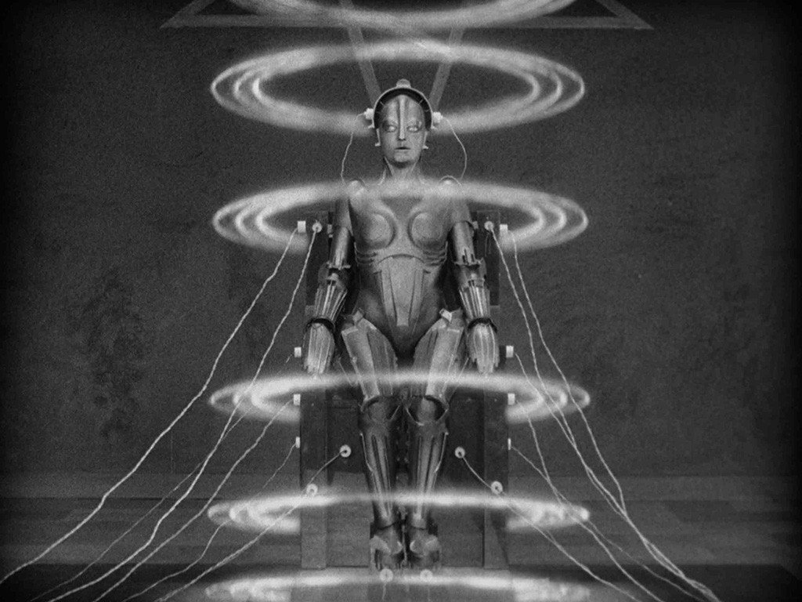
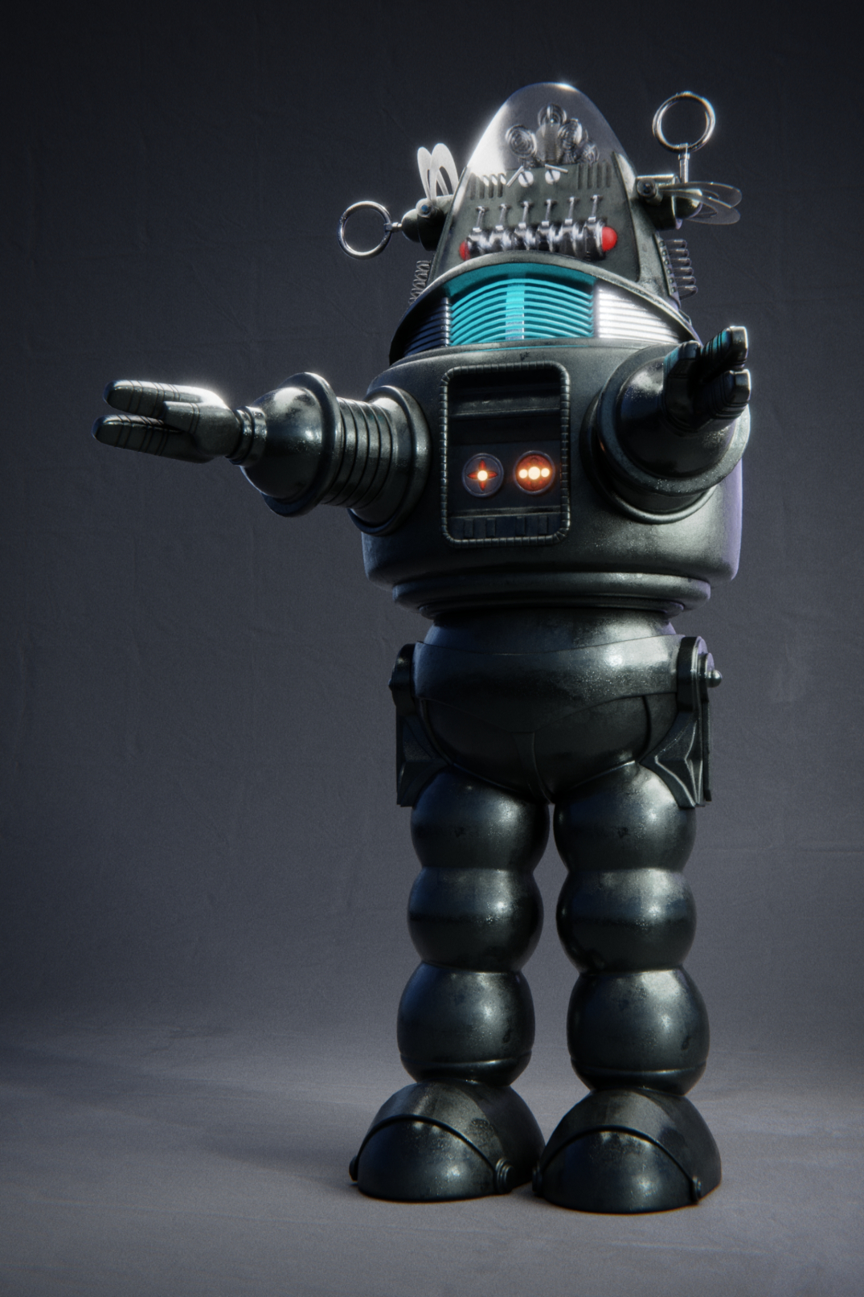
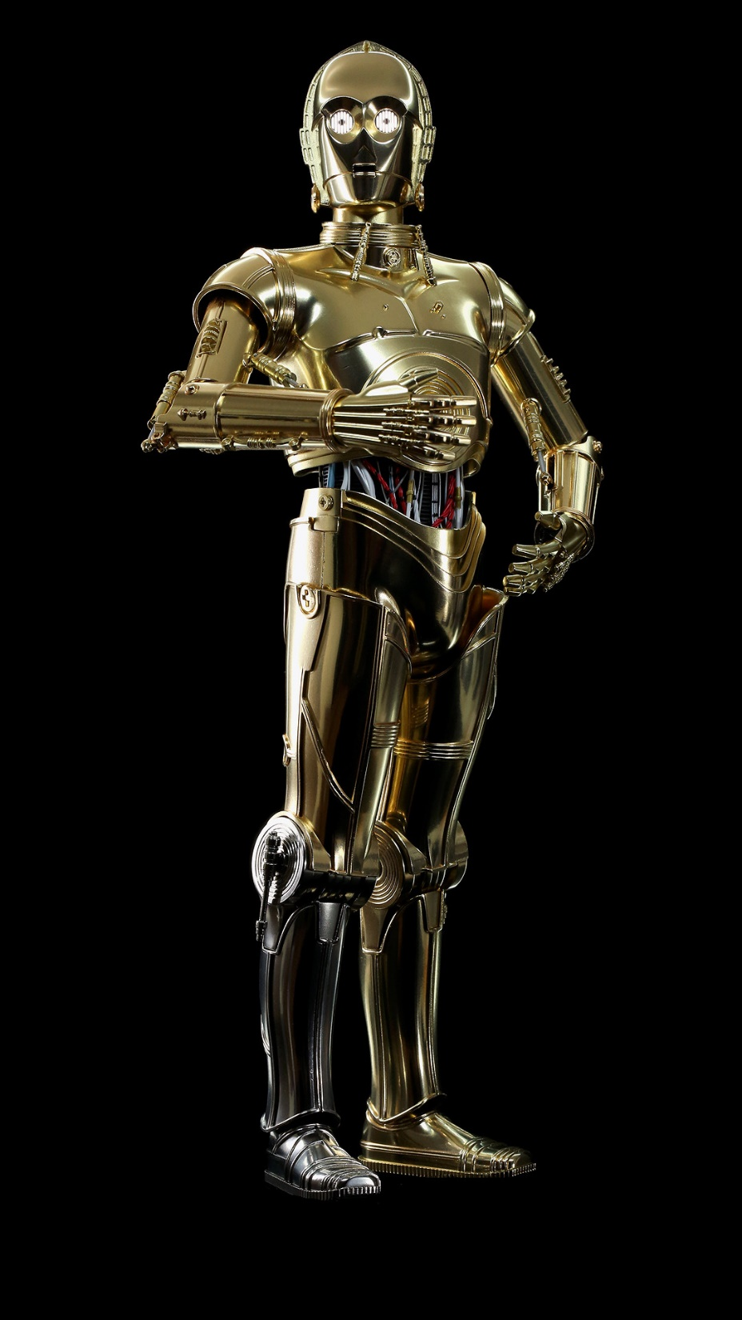
Notes:
The focus of the exhibition at the NMS is on humanoid robots and robots that mimic human behaviour.
Here are some famous ones over a period of nearly 100 years…
Maria from Metropolis – 1927
Robbie from Forbidden Planet – 1956
C3PO from Star Wars – 1977

Slide 7
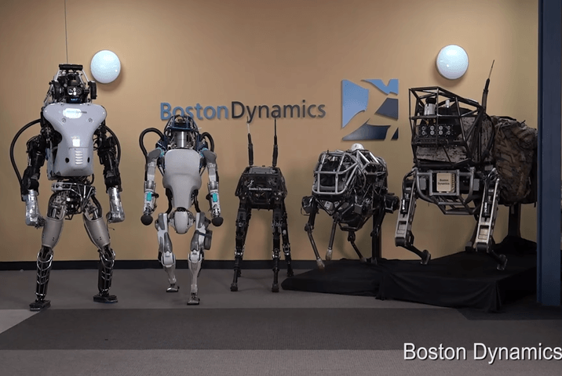
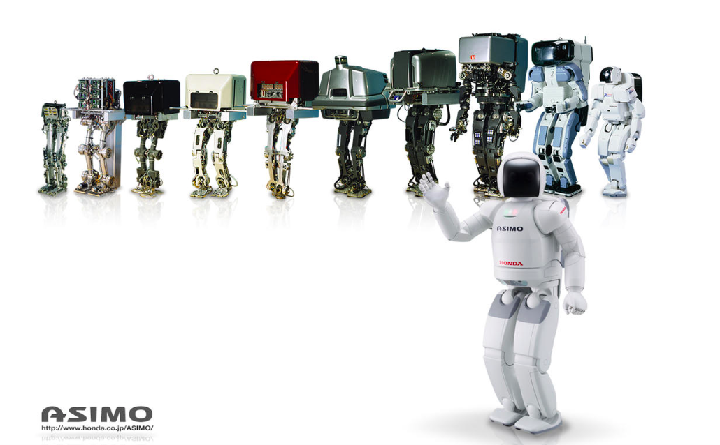
Notes:
Humanoid research robots sometimes have a long development history… going through many development cycles… e.g. at Honda and Boston Dynamics…

Slide 8
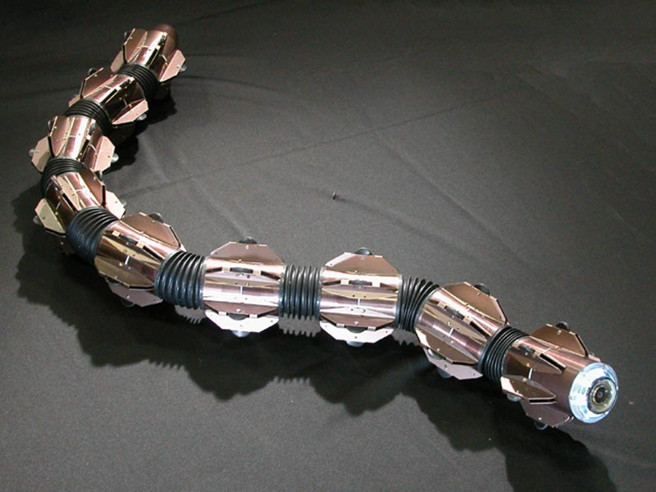
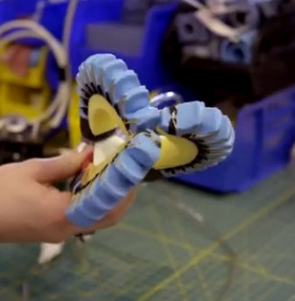
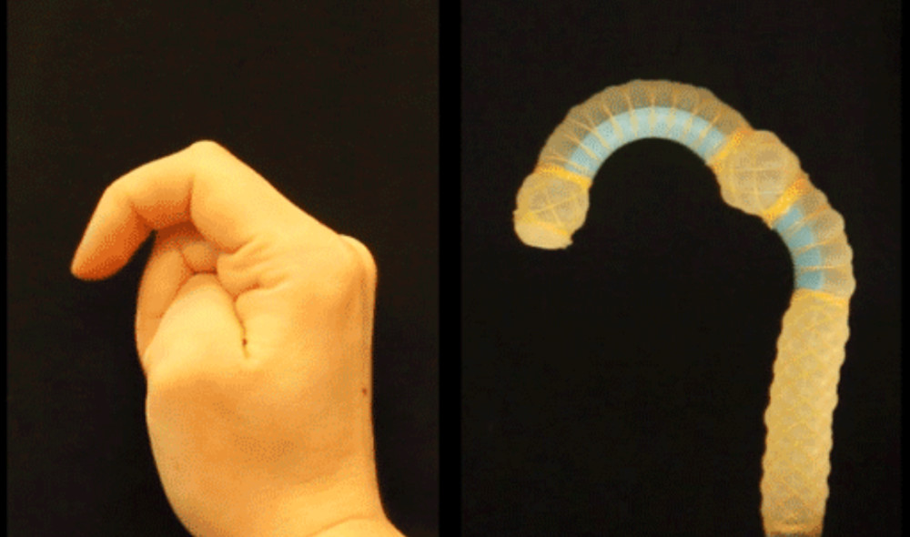
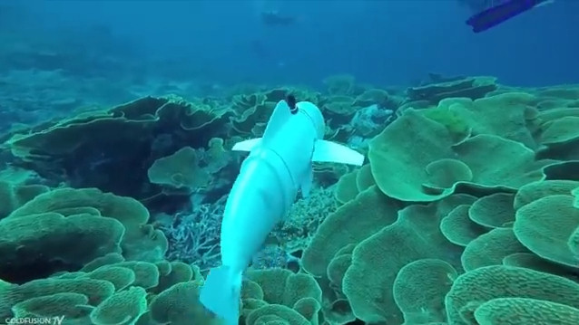
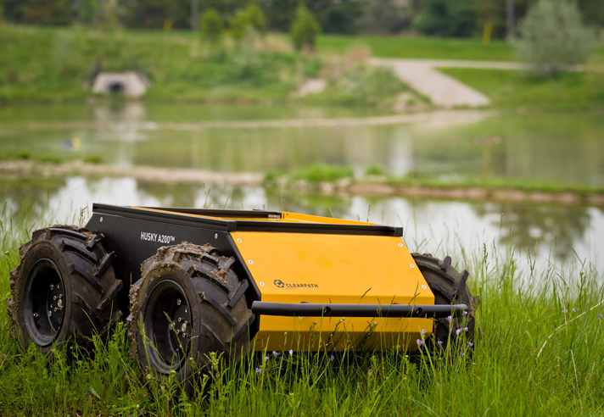
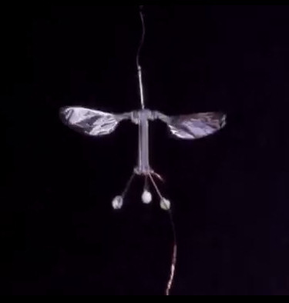
Notes:
Multiple Robot Form Factors…
Soft Robots – Harvard Robotics Lab
The Future of Things.

Slide 9
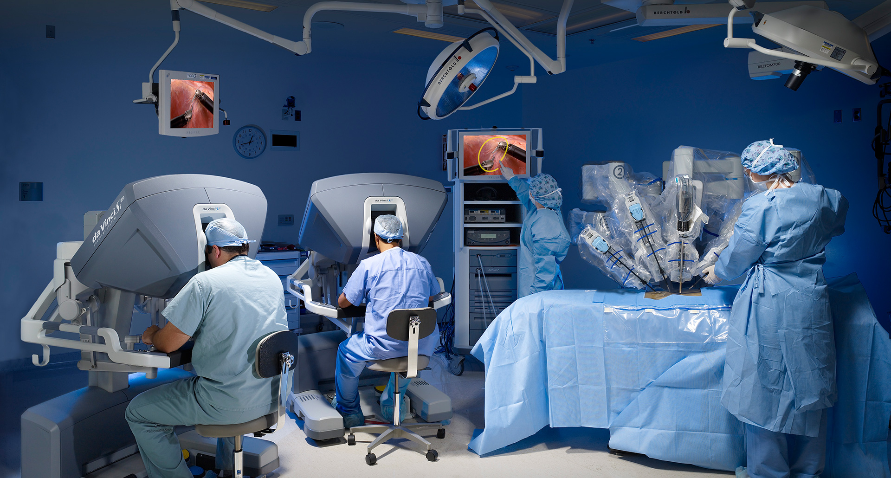
Notes:
Robots can also work alongside and assist humans... E.g. Sofmedica Da-Vinci Surgical Robot.

Slide 10
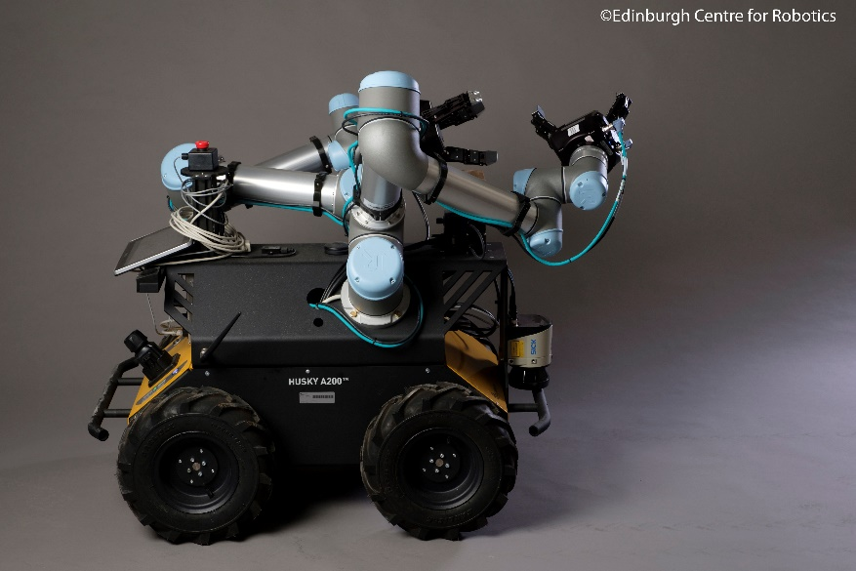
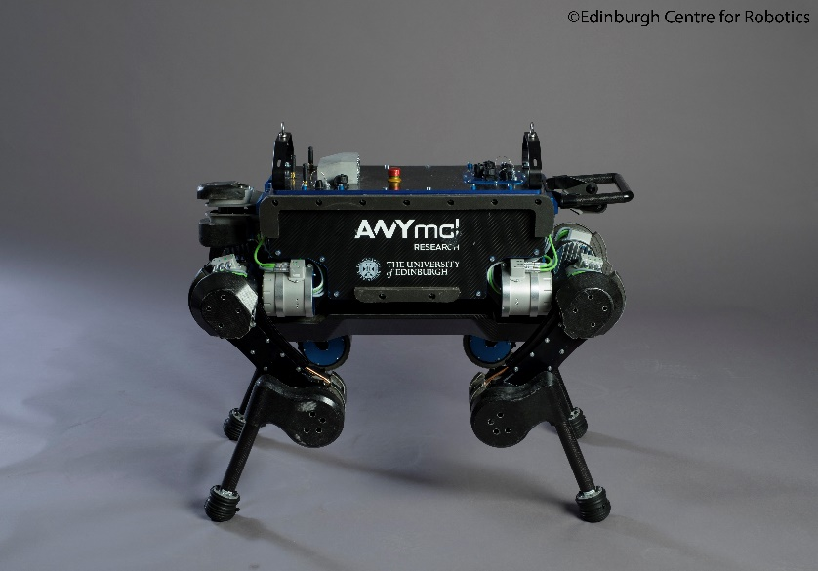
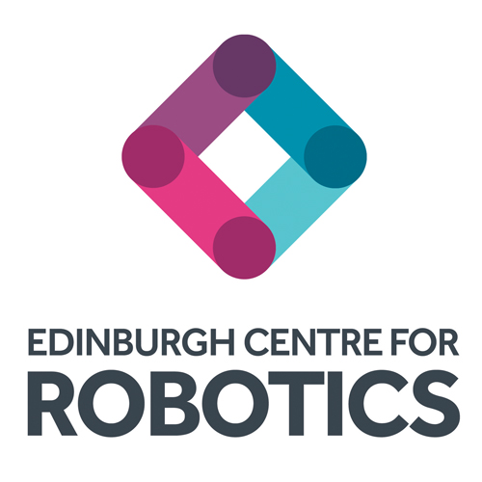
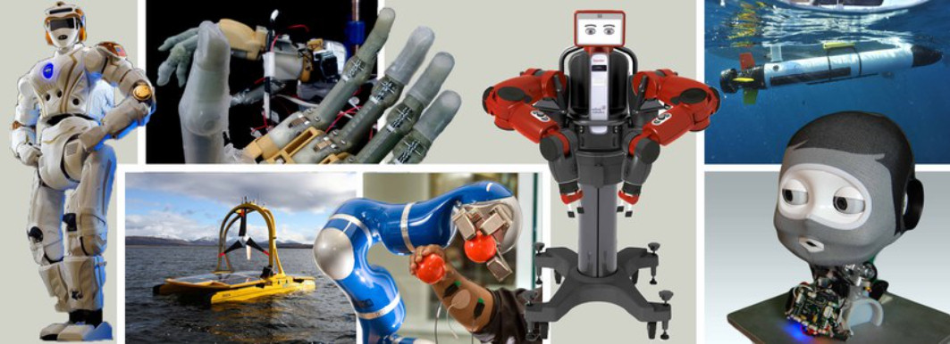
Notes:
Edinburgh Centre for Robotics. Robotarium Robots. A wide variety of robot form factors in use.

Slide 11
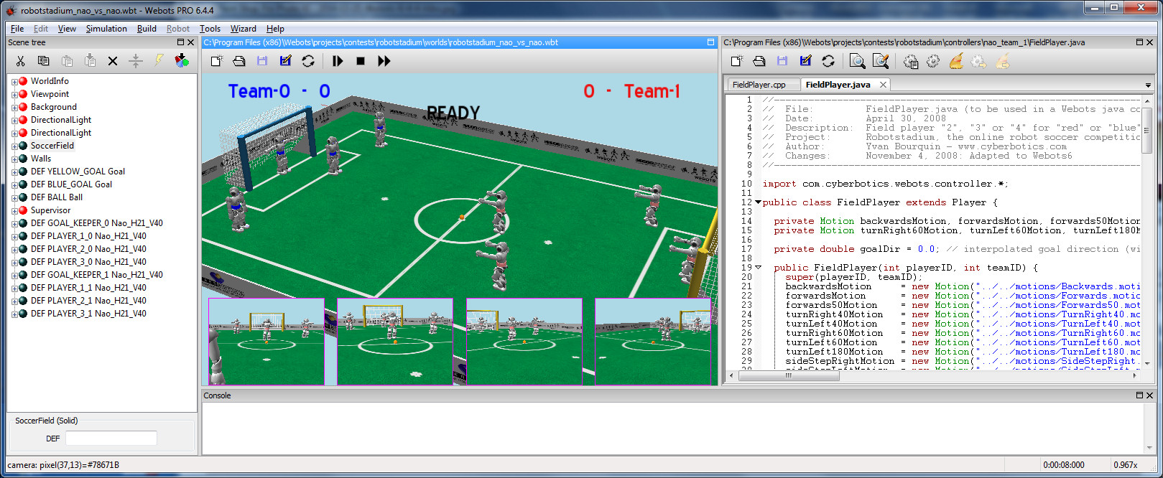
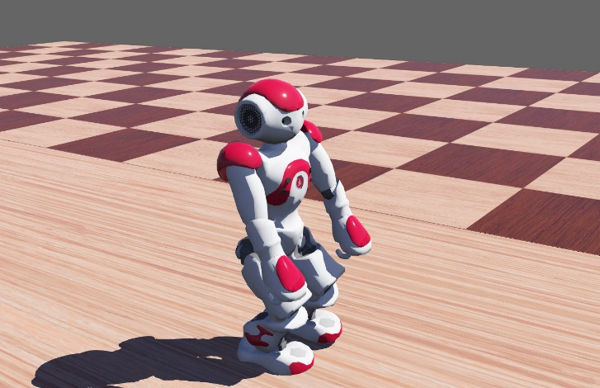
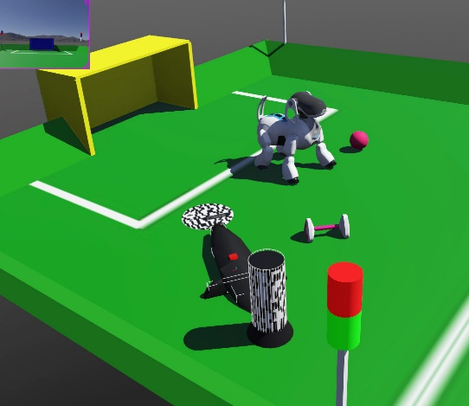
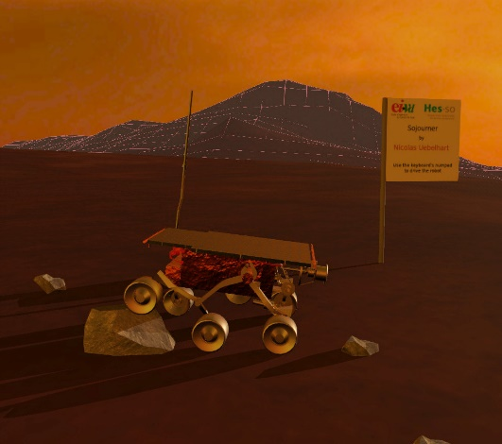
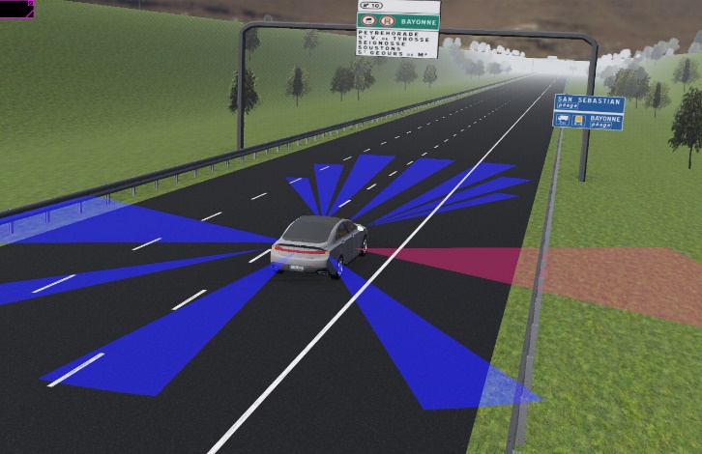
Notes:
In education and research testing often simulators are used such as the Cyberbotics Webots and ROS robot simulators.
https://cyberbotics.com/
http://www.ros.org/

Slide 12
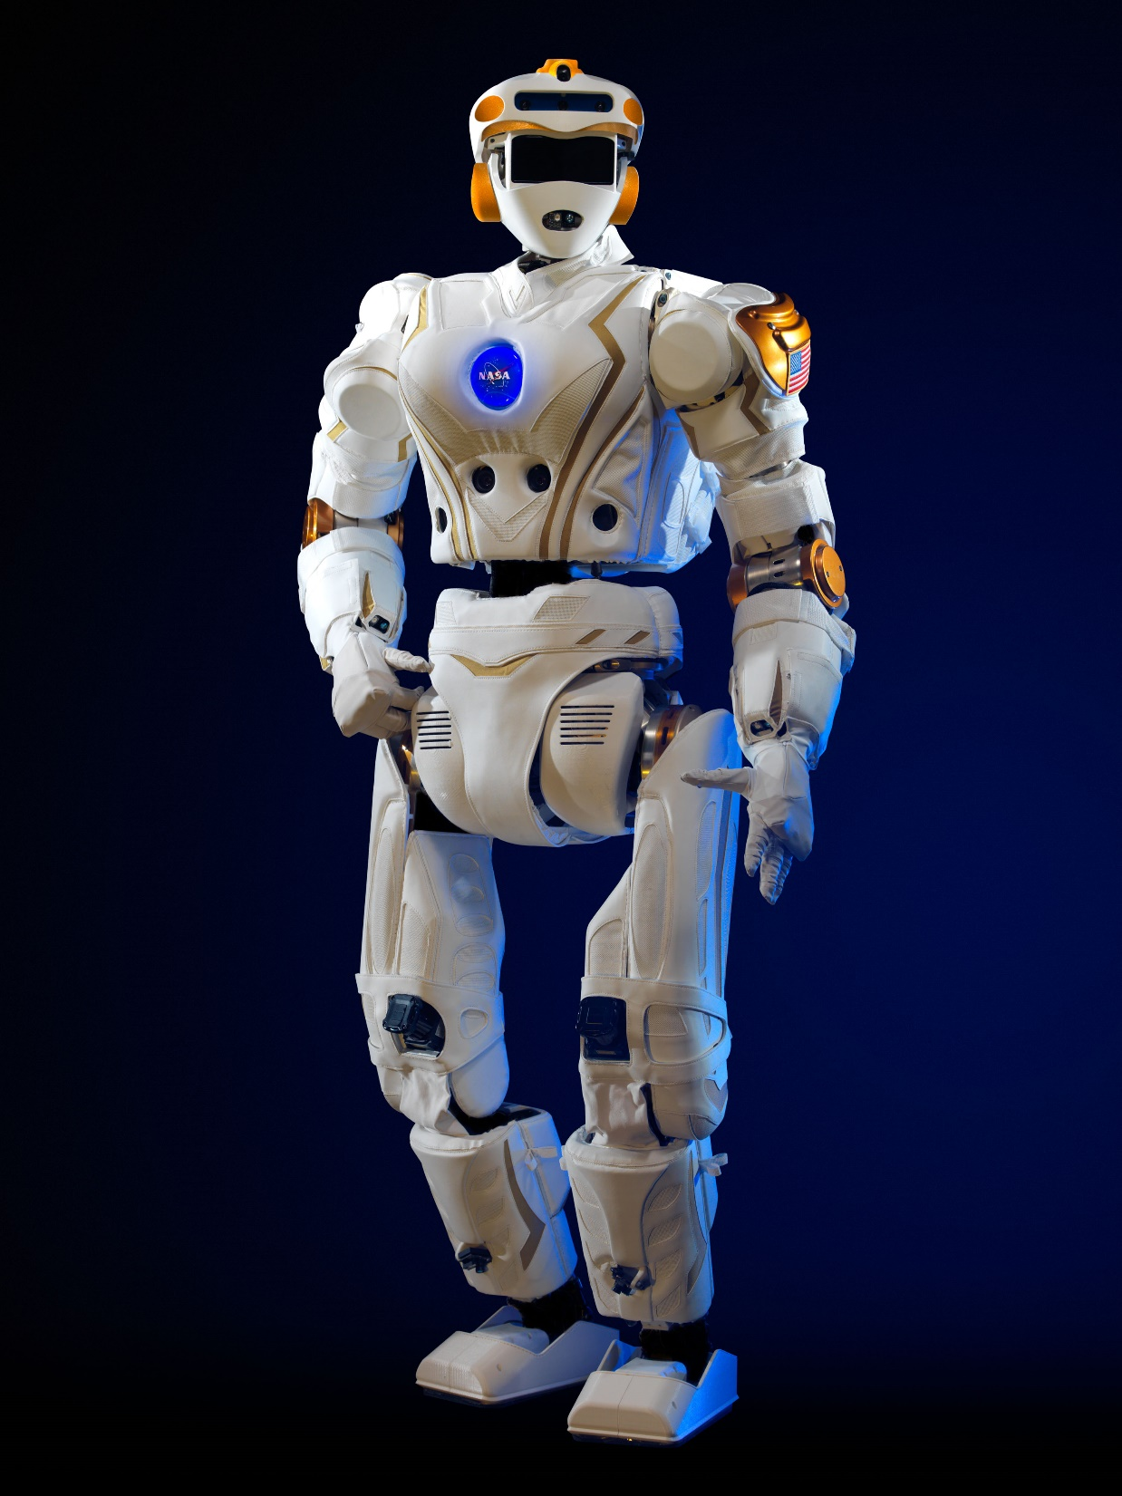
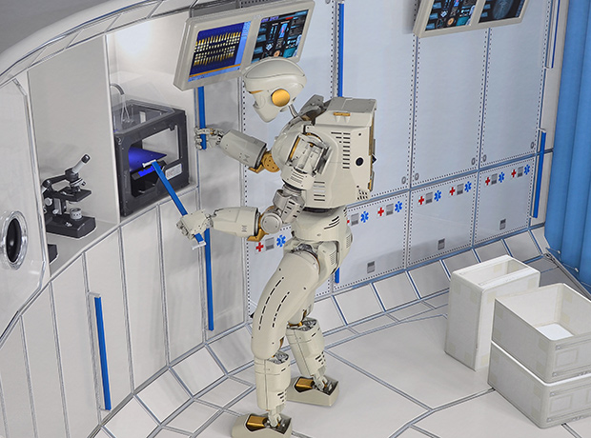
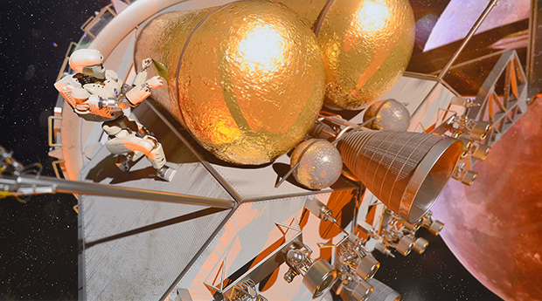
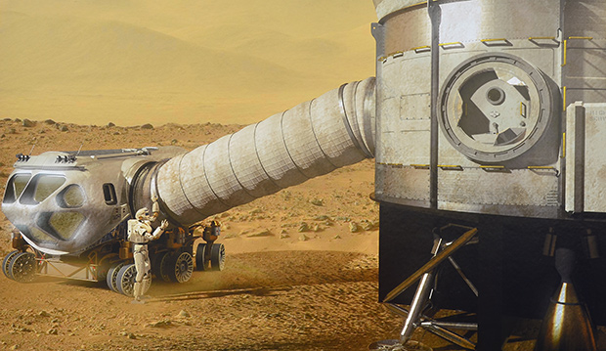
Notes:
In the Edinburgh Centre for Robotics there is a humanoid robot, the NASA Valkyrie Robot. Applications to prototype human operations for space missions and on Mars.

Slide 13
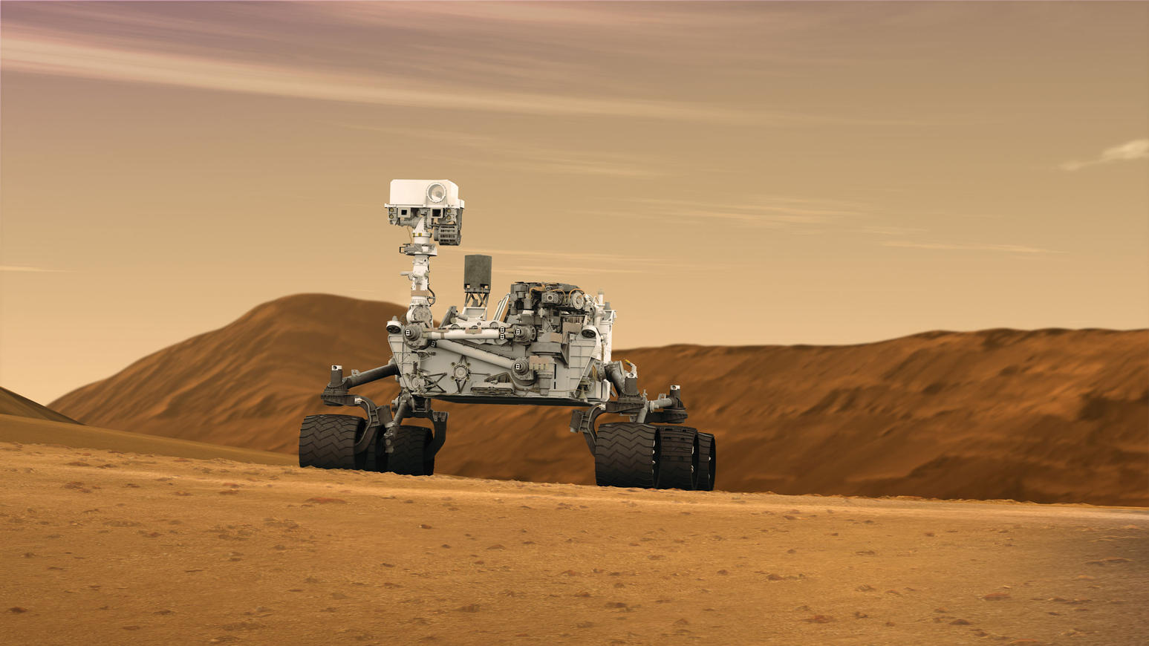
Notes:
Other space-application robots include the NASA Curiosity Rover. It uses AI on the ground and on board to assist in its navigation and control.

Slide 14
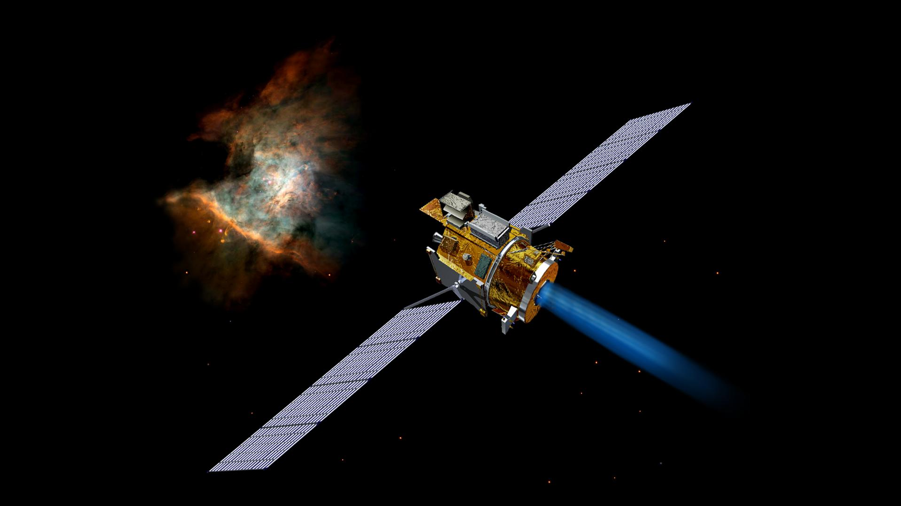
Notes:
NASA Deep Space One. Launched 24 October 1998 to Comet Borrelly.
Remote Agent (RAX), remote intelligent self-repair and control software developed at NASA's Ames Research Center and the Jet Propulsion Laboratory, was the first on-board artificial intelligence system to control a spacecraft without human supervision
https://solarsystem.nasa.gov/missions/deep-space-1/in-depth/

Slide 15
Notes:
Robots.

Slide 16
Credits
Presentation available at http://www.aiai.ed.ac.uk/~ai/resources/
National Museum of Scotland – Tayce Phillipson and Kirsty Tough
Science Museum London
Disney/LucasFilm, MGM – Sci-Fi Film Robots
University of Edinburgh – Freddy Robot
Edinburgh Centre for Robotics – Robotarium Robots
Da-Vinci Surgical Robot – Sofmedica
Soft Robots – Harvard Robotics Lab
Webots – Cyberbotic
Valkyrie, Curiosity Rover and Deep Space One – NASA Images
Notes:
Credits.

